Slide 1
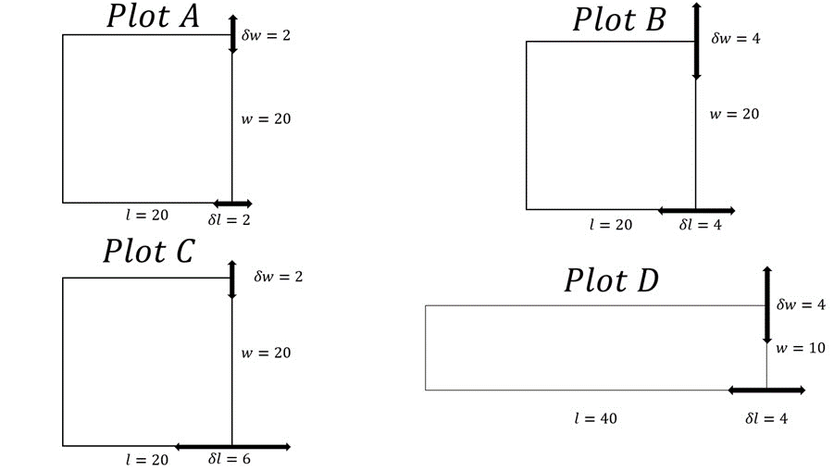
[Lab 3] Propagation of Uncertainty
Plot | L | dL | W | dW | A
A | 20 | 2 | 20 | 2 | 400
B | 20 | 4 | 20 | 4 | 400
C | 20 | 6 | 20 | 2 | 400
D | 40 | 4 | 10 | 4 | 400
So, how do we determine dA?

Slide 2

[Lab 3] Propagation of Uncertainty
$$A±dA=\left(L±dL\right)∗(W±dW)$$
First Guess:
Plot | L | dL | W | dW | A
A | 20 | 2 | 20 | 2 | 400
B | 20 | 4 | 20 | 4 | 400
C | 20 | 6 | 20 | 2 | 400
D | 40 | 4 | 10 | 4 | 400
dL*dW | First Guess
4
16
12
16

Slide 3

[Lab 3] Propagation of Uncertainty
$$A±dA=\left(L±dL\right)∗(W±dW)$$
First Guess:
$$A±dA=LW±LdW±WdL±dLdW$$
Just as likely to cancel as to add!
Plot | L | dL | W | dW | A
A | 20 | 2 | 20 | 2 | 400
B | 20 | 4 | 20 | 4 | 400
C | 20 | 6 | 20 | 2 | 400
D | 40 | 4 | 10 | 4 | 400
dL*dW | First Guess
4 | dA = 84
16 | dA = 176
12 | dA = 172
16 | dA = 216

Slide 4
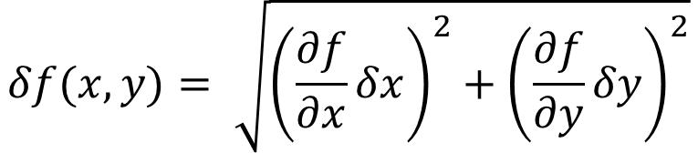
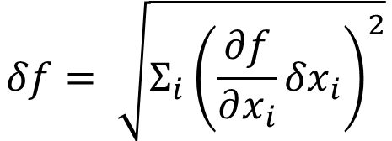
[Lab 3] Propagation of Uncertainty
Each uncertainty contributes to the total uncertainty proportional to the partial derivative (slope of f with respect to that variable)
Multiple sources don’t simply add but add “in quadrature”, since they are as likely to cancel as add
We will always give you the needed derivatives
$$δf= \sqrt{Σ_{i}{\left(\frac{∂f}{∂x_{i}}{δx}_{i}\right)}^{2}}$$
For example, if f is a function of two variables, then…
$$δf(x,y)= \sqrt{{\left(\frac{∂f}{∂x}δx\right)}^{2}+{\left(\frac{∂f}{∂y}δy\right)}^{2}}$$

Slide 5

[Lab 3] Propagation of Uncertainty
$$A±dA=\left(L±dL\right)∗(W±dW)$$
First Guess:
$$A±dA=LW±LdW±WdL±dLdW$$
Final Answer:
$$dA= \sqrt{(LdW)^{2}+(WdL)^{2}}$$
Plot | L | dL | W | dW | A
A | 20 | 2 | 20 | 2 | 400
B | 20 | 4 | 20 | 4 | 400
C | 20 | 6 | 20 | 2 | 400
D | 40 | 4 | 10 | 4 | 400
dL*dW | First Guess | Final Answer
4 | dA = 84 | ≈57
16 | dA = 176 | ≈113
12 | dA = 172 | ≈126
16 | dA = 216 | ≈165
*Remember to follow proper conventions with rounding/sig figs when reporting uncertainty.

Slide 6
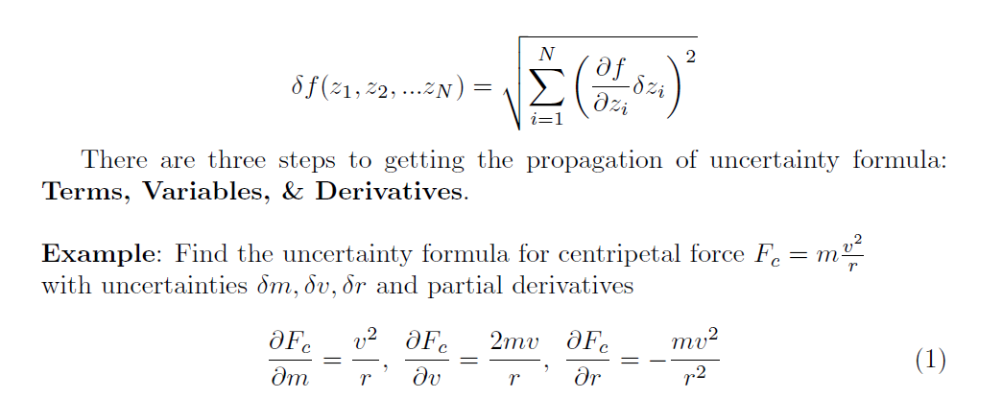
[Lab 3] Propagation of Uncertainty

Slide 7
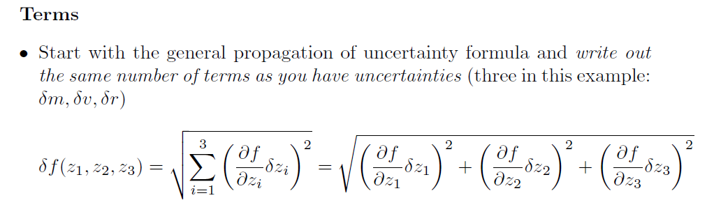
[Lab 3] Propagation of Uncertainty

Slide 8
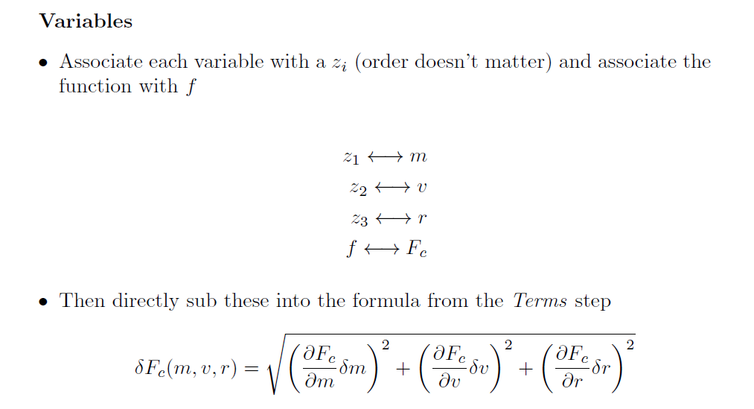
[Lab 3] Propagation of Uncertainty

Slide 9
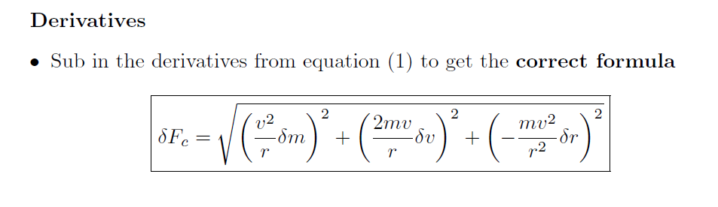
[Lab 3] Propagation of Uncertainty

Slide 10
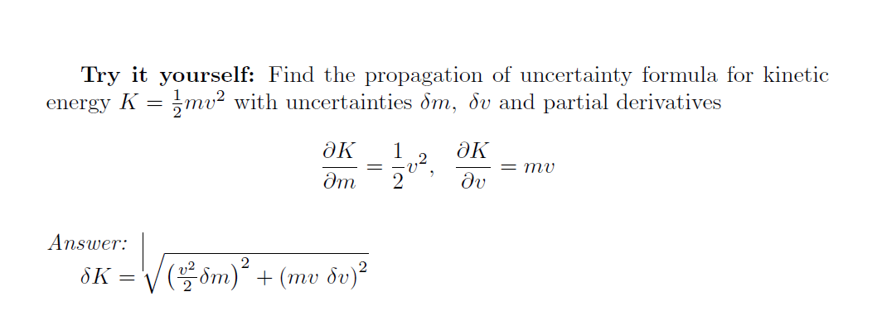
[Lab 3] Propagation of Uncertainty

Slide 11

[Lab 3] Propagation of Uncertainty

